Slide 1



Intelligent Application
Building a CNN for Handwritten Digit Recognition
Zehra KOLAT | Student ID: 206001007
Introduction to Large Language Models | Istinye University

Slide 2


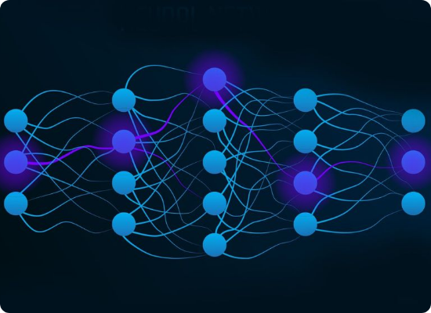
The Challenge
Can a machine "see" numbers?
Goal: Classify handwritten digits (0-9).
Complexity: Different handwriting styles and thicknesses.
Solution: Use Convolutional Neural Networks (CNN) to extract visual features automatically.

Slide 3






Chosen Track
Track 2
Dataset
Framework
Focused on Computer Vision and deep learning implementations.
Using the MNIST benchmark with 60,000 images split into Train/Val/Test sets.
Built with PyTorch using modern layers like Conv2d and Dropout.

Slide 4

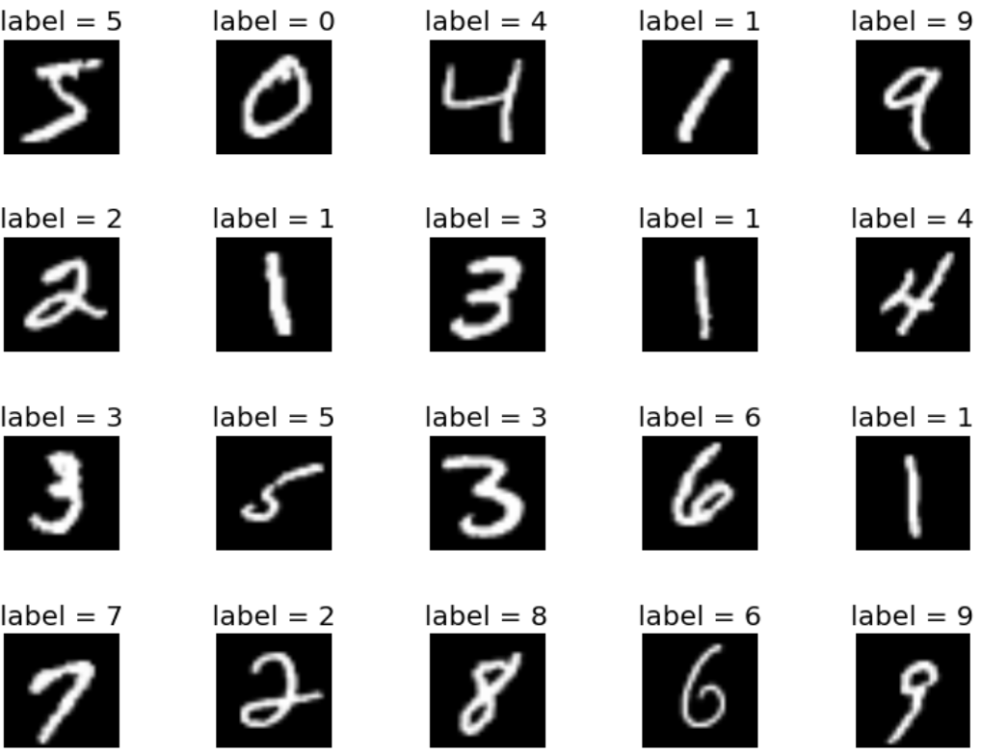

Data Preparation
Before training, the data goes through 3 essential steps:
1.
1. Normalization: Adjusting pixel values for faster learning (Mean: 0.1307, Std: 0.3081).
2.
2. Splitting: 60% Train, 20% Val, 20% Test to ensure the model generalizes.
3.
3. Batching: Loading 64 images at a time for stable gradient updates.

Slide 5



The Model "Brain"
Feature Extraction
Downsampling
Classification
Two Convolutional Layers (32 & 64 filters) to detect lines and curves.
Max Pooling layers to reduce spatial size and focus on the most important pixels.
Two Fully Connected layers that map features to the final 10 digits.
Regularization: 50% Dropout used to prevent overfitting.

Slide 6

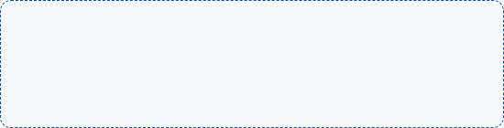
The Training Loop
How the model improves over time:
Optimizer: Adam (Adaptive Learning Rate).
Loss: Cross-Entropy (Measures prediction error).
Learning Update Rule
Strategy: Backpropagation via the Chain Rule.
Safety: Early Stopping stops training if the model stops improving.

Slide 7


Final Results
TEST ACCURACY
99.15%
Why is this great?
Our model reached peak performance in just 16 epochs. It is highly robust across all classes (0-9).
Weighted F1-Score: 0.99
Out of 10,000 images

Slide 8

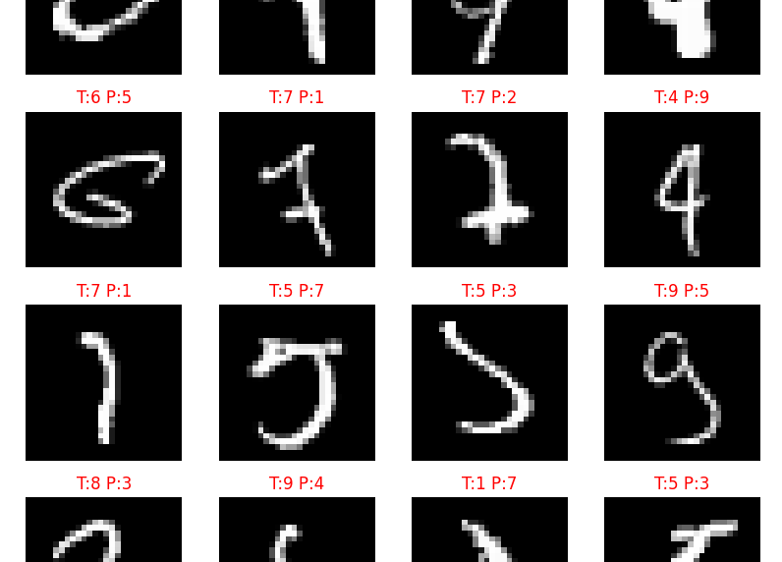
Error Analysis
Where did it struggle?
The Confusion Matrix shows that errors are rare, but when they happen, they involve:
4 vs 9: Similar loop structures.
2 vs 7: Some handwritten styles look alike.
Overall, the model is near-human performance on this task.

Slide 9




Conclusion
Success
Generalization
Scalability
The CNN architecture is perfect for this task, extracting hierarchy of features automatically.
Regularization (Dropout) ensured the model works on unseen data, not just training data.
This same architecture can be scaled to recognize more complex objects (Cifar-10 or ImageNet).

Slide 10




Thank You!
Code Repository
2-Min Pitch Link
Full Report
Zehra KOLAT | 2026 ISTINYE UNIVERSITY

